Slide 1

Secured Wi-Fi Enabled USB Flash Drive
University of Dar es Salaam
Student’s name: | Kowero, Walidi Waziri
Registration No: | 2020-04-04390
Degree Programme: | B.Sc. Electronics Engineering
Supervisor: | Prof. Baraka Maiseli
Electronics and Telecommunications Engineering
ES 499: Final Year Project
01

Slide 2

Outline
University of Dar es Salaam
Introduction
The Existing System
Weaknesses of the current system
Main objective of the project
Comment table
Specific objectives
Scope of the Project
Methodology
System Requirements
System Design
Project timeline
Work done so far
Electronics and Telecommunications Engineering
ES 499: Final Year Project
02

Slide 3
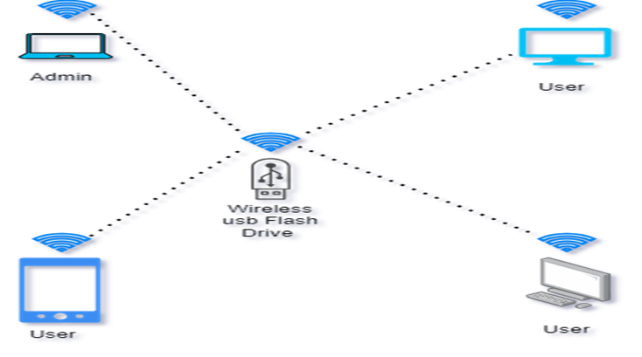
Introduction
University of Dar es Salaam
This project aim at increasing mobility and flexibility by using the 2.4GHz radio technology and Wi-Fi protocols to improve ways to securely transfer data across devices.
Electronics and Telecommunications Engineering
ES 499: Final Year Project
03

Slide 4
Problem statement
University of Dar es Salaam
In the realm of data storage, there's a growing demand for enhanced flexibility and seamless file sharing capabilities
The existing ways /solutions offer commendable features like high data transfer rates and security measures, there's an opportunity to innovate further..
As people’s demand continue to grow, developing solutions which not only provide simplicity and compatibility but also increase flexibility and security standards, so that individuals and businesses can enjoy a high quality of experience."
Electronics and Telecommunications Engineering
ES 499: Final Year Project
03

Slide 5
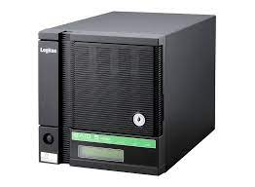
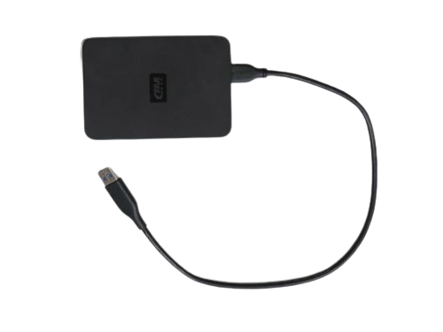
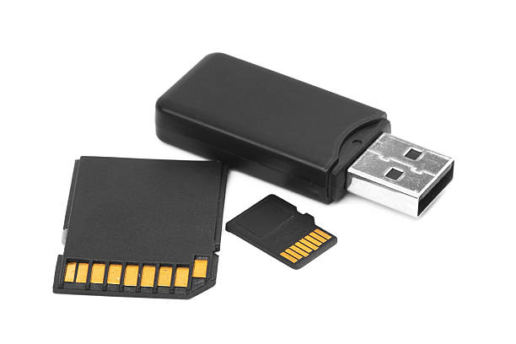
The existing system
University of Dar es Salaam
Most of the existing wireless USB flash drive uses middleware to perform data transfer and provides single way to access data
Electronics and Telecommunications Engineering
ES 499: Final Year Project
04

Slide 6
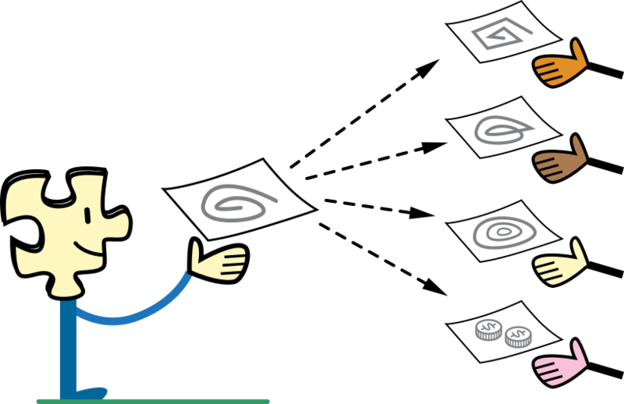
Weakness of the existing system
University of Dar es Salaam
Enclosed to the existing ecosystem of mass file sharing system.
Unreliable data security.
Electronics and Telecommunications Engineering
ES 499: Final Year Project
05

Slide 7
Comment Table
University of Dar es Salaam
Comment from last presentation | Implementation of the comment | Where shown
To redefine the problem statement | Problem statement is redefined to a more positive way | At project problem statement
Electronics and Telecommunications Engineering
ES 499: Final Year Project
06

Slide 8
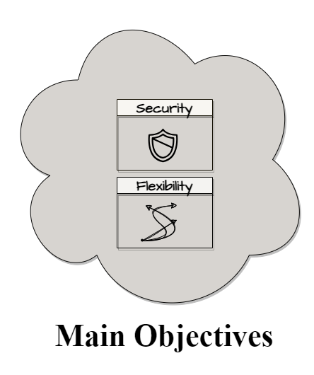
Main objective
University of Dar es Salaam
To enhance flexibility and security in wireless flash storage devices.
Electronics and Telecommunications Engineering
ES 499: Final Year Project
07

Slide 9
Specific objectives
University of Dar es Salaam
To establish system requirement for wireless data transfer
To implement secure ways of data transfer wirelessly
To implement multipoint user-friendly interfaces
Electronics and Telecommunications Engineering
ES 499: Final Year Project
08

Slide 10

Scope of the project
University of Dar es Salaam
Local individuals using edge devices and personal computers.
Local companies and Institutes
Electronics and Telecommunications Engineering
ES 499: Final Year Project
09

Slide 11
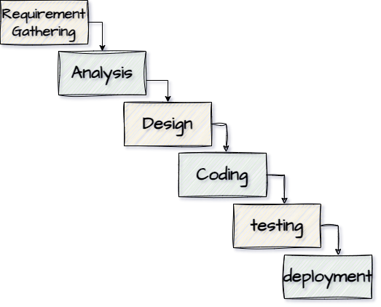
Methodology
University of Dar es Salaam
Electronics and Telecommunications Engineering
ES 499: Final Year Project
10

Slide 12
System requirements: Functional Requirements
University of Dar es Salaam
Read/Write File
Wireless Access
Wired/USB Mode
Multi-device Access
Remote Management
Electronics and Telecommunications Engineering
ES 499: Final Year Project
11

Slide 13
System requirements: Non-Functional Requirement
University of Dar es Salaam
Low Power Consumption
High data Transfer Speed
Response Time
Data integrity
Cross-Platform Compatibility
Electronics and Telecommunications Engineering
ES 499: Final Year Project
12

Slide 14
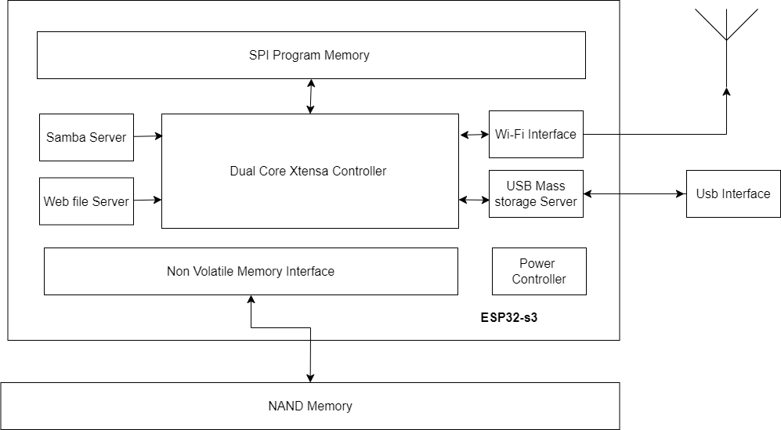
System Design: Block diagram
University of Dar es Salaam
Electronics and Telecommunications Engineering
ES 499: Final Year Project
13

Slide 15
System Design : Flowchart
University of Dar es Salaam
Start
Enabling Wi-Fi Access Point
Mass Storage Server
SMB Server
Web File Server
Error Handling
Serve Forever
NO
If error
YES
Electronics and Telecommunications Engineering
ES 499: Final Year Project
14

Slide 16

Methodology
University of Dar es Salaam
Method used is trial and error through a series of experimentations instead of CAD simulation.
Electronics and Telecommunications Engineering
ES 499: Final Year Project
15

Slide 17
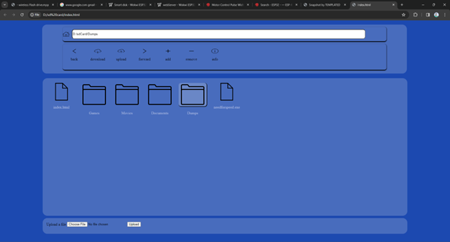
Methodology: tools
University of Dar es Salaam
Platform used to achieve web development is visual studio codes,
Platform used to achieve web Server is Wokwi
Meanwhile the remaining programming is Arduino IDE
Electronics and Telecommunications Engineering
ES 499: Final Year Project
15

Slide 18
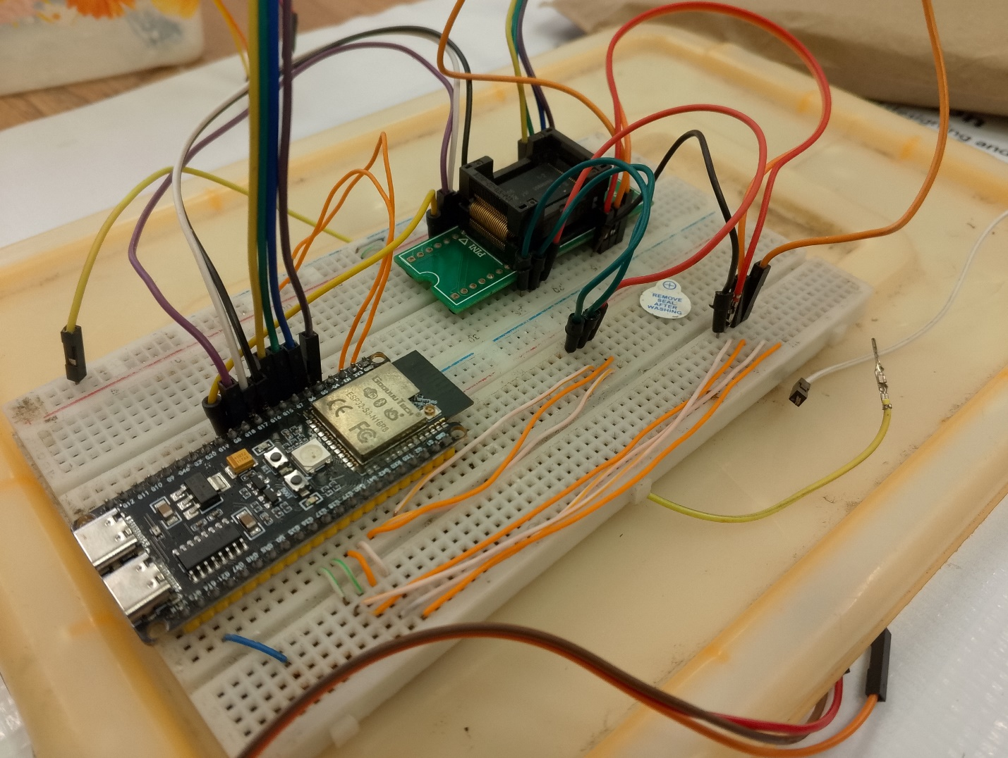
Work done so far
University of Dar es Salaam
Prototype setup for experimentation of Wireless Usb flash drive
Web Server with captive portal for automatic web page redirecting
Usb MSC server
Electronics and Telecommunications Engineering
ES 499: Final Year Project
15

Slide 19
Limitations
University of Dar es Salaam
Start
Enabling Wi-Fi Access Point
Mass Storage Server
SMB Server
Web File Server
Hardest
Error Handling
Hard
Serve Forever
Normal
If error
NO
Simple
Condition
YES
Electronics and Telecommunications Engineering
ES 499: Final Year Project
15

Slide 20
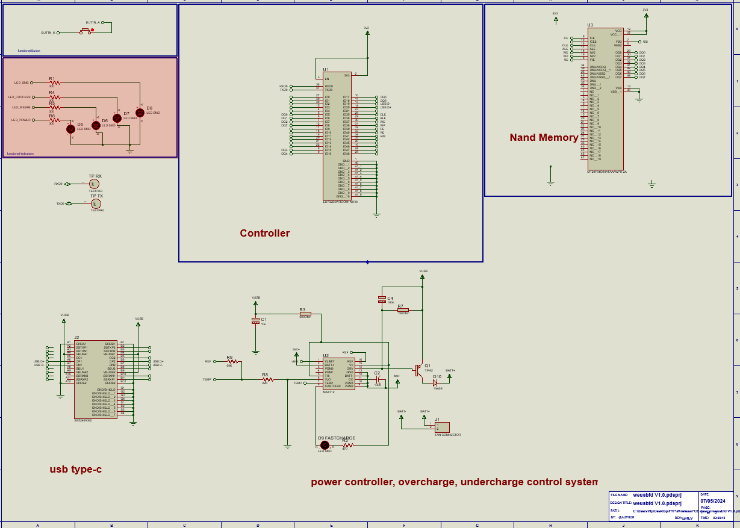
Working Progress
University of Dar es Salaam
1.
PCB designing
2.
Optimizing Nand Memory Read/Write speed
3.
Encasing designing
Electronics and Telecommunications Engineering
ES 499: Final Year Project
15

Slide 21
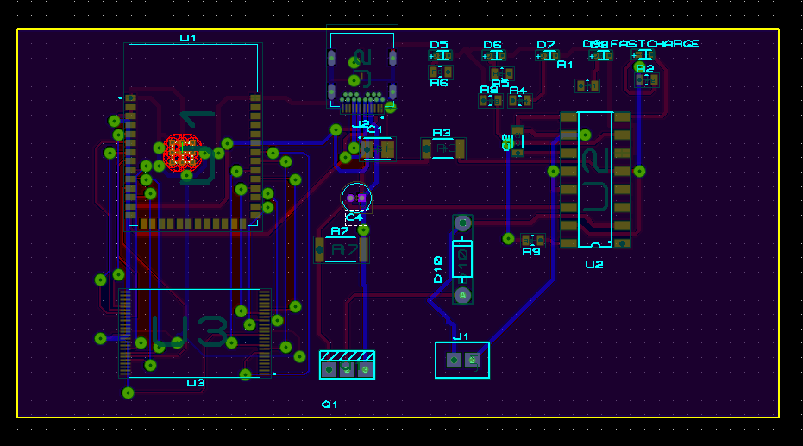
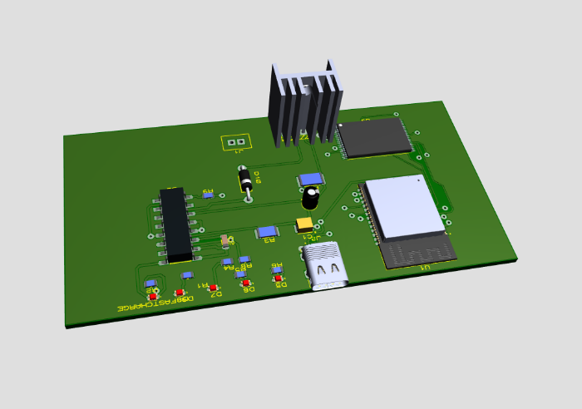
Working Progress
University of Dar es Salaam
Electronics and Telecommunications Engineering
ES 499: Final Year Project
15

Slide 22
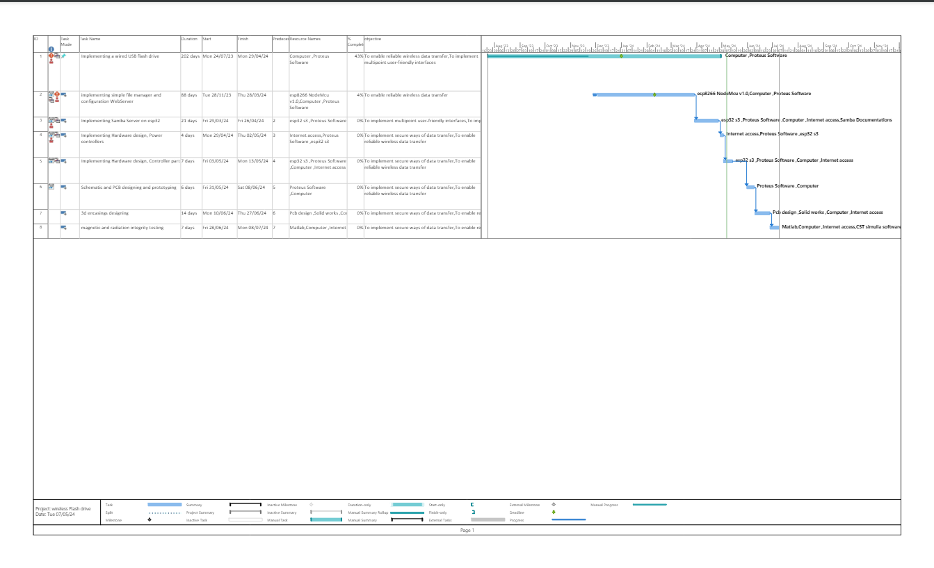
Project timeline
University of Dar es Salaam
Electronics and Telecommunications Engineering
ES 499: Final Year Project
16

Slide 23
Thank you!
University of Dar es Salaam
Electronics and Telecommunications Engineering
ES 499: Final Year Project
18

